Slide 1
Final part/chapter of the Autonomic Nervous System Pharmacology
Introductory Pharmacology PHAR2001
Dr. Ken Wojcikowski

Slide 2
Objectives
Explain the difference between direct-acting and indirect-acting Parasympathomimetic drugs
Know terms used to describe the parasympathomimetic drugs, for instance, muscarinic drugs, cholinergic agents, acetylcholine agonists.
Describe the actions interactions and side effects of the:
  Direct acting cholinergic agonists bethanechol and pilocarpine
  Indirect acting cholinergic agonists neostigmine and donepezil
  The antimuscarinic agents, using atropine as an example.

Slide 3
Drugs of the Parasympathetic Nervous System (PNS)
Lesson 1:
Understanding Acetylcholine, the neurotransmitter for the PNS (and the muscles – how can that be?)
Autonomic Nervous System Pharmacology
Introductory Pharmacology PHAR2001
Dr Ken Wojcikowski

Slide 4
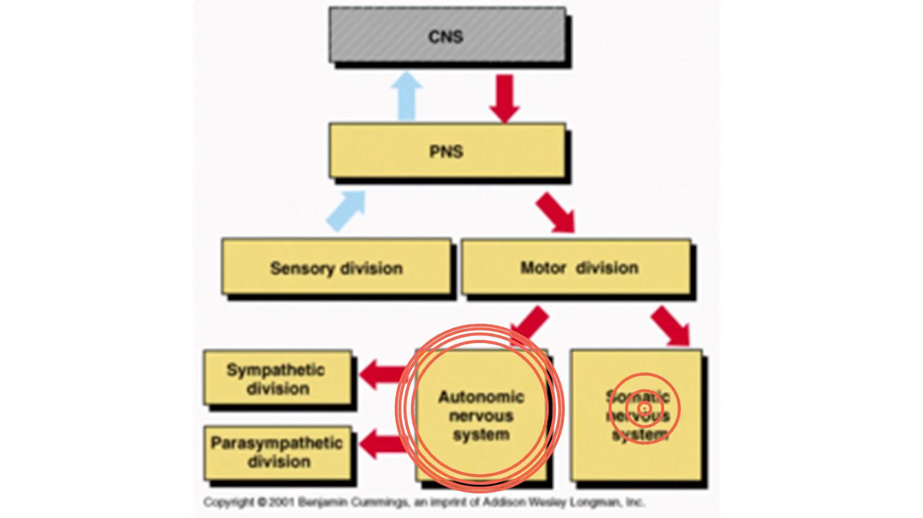

Slide 5
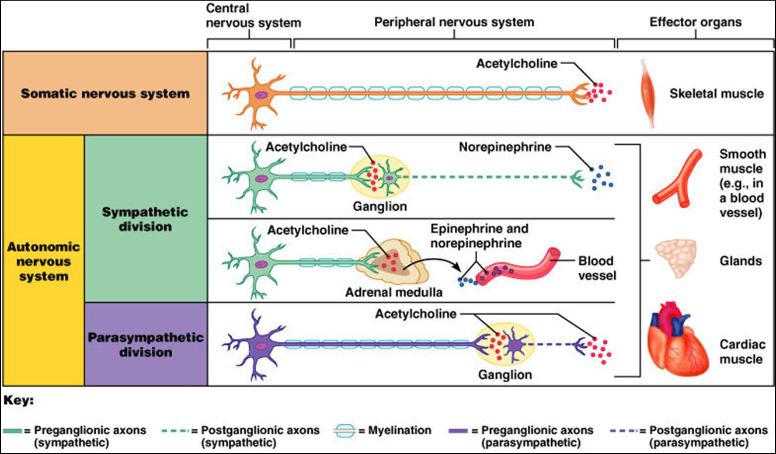
Neurotransmitters of the ANS
From: Pearson Education Inc.
Benjamin Cummings
(Neurotransmitters are degraded by COMT and MAO in the SNS and Acetylcholinesterase in the PNS)

Slide 6
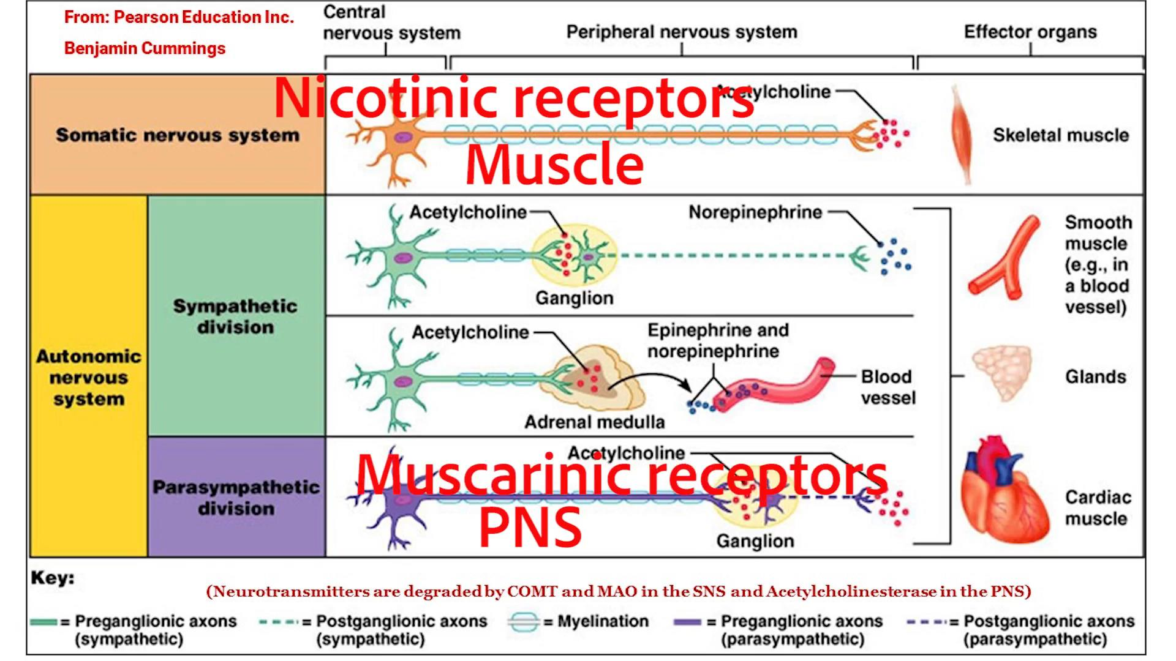
Acetylcholine binding
Skeletal muscle = nicotinic receptors.
PNS= muscarinic receptors

Slide 7
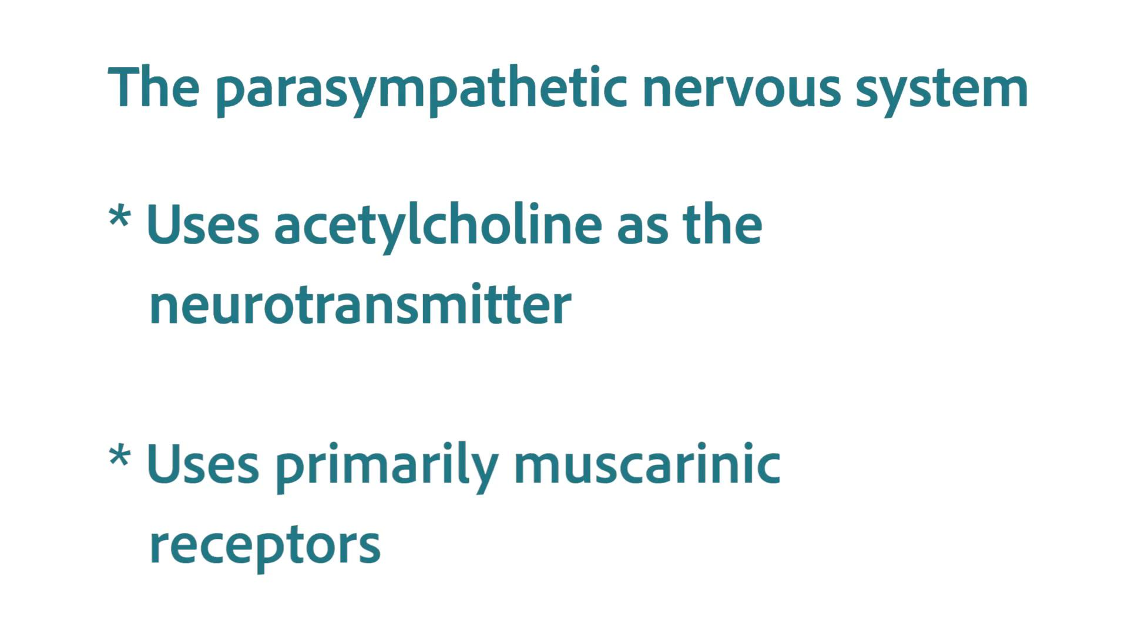

Slide 8
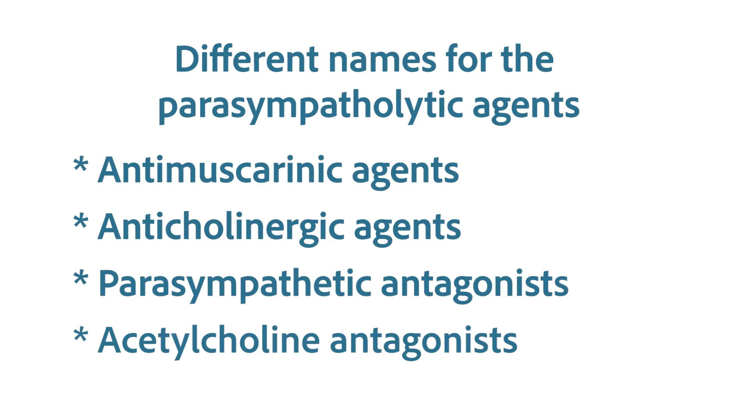

Slide 9
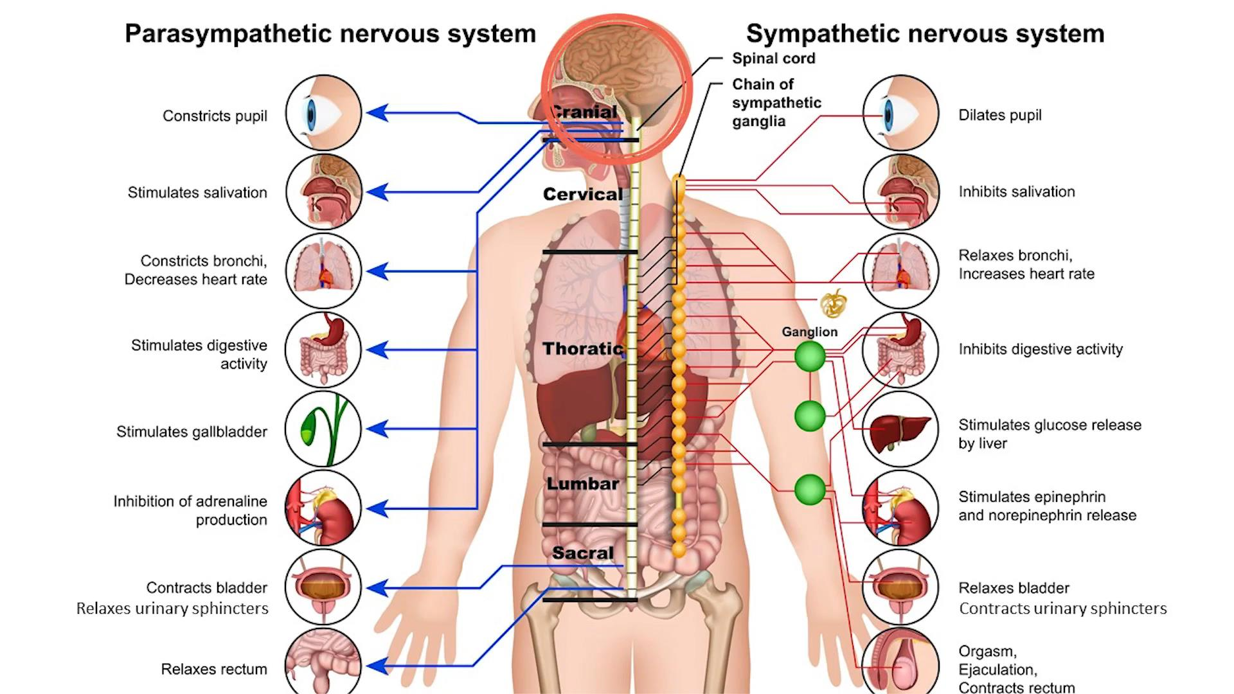
Anticholinergic agents that break into the brain are associated with dementia

Slide 10
Drugs of the Parasympathetic Nervous System (PNS)
Lesson 2:
Important foundational information about the PNS
Autonomic Nervous System Pharmacology
Introductory Pharmacology PHAR2001
Dr Ken Wojcikowski

Slide 11
The parasympathetic nervous system
The ‘rest and digest’ system
  Heart rate slows down
  Digestion begins
  Pupils constrict
Think about the last time
you were able to relax

Slide 12



Slide 13
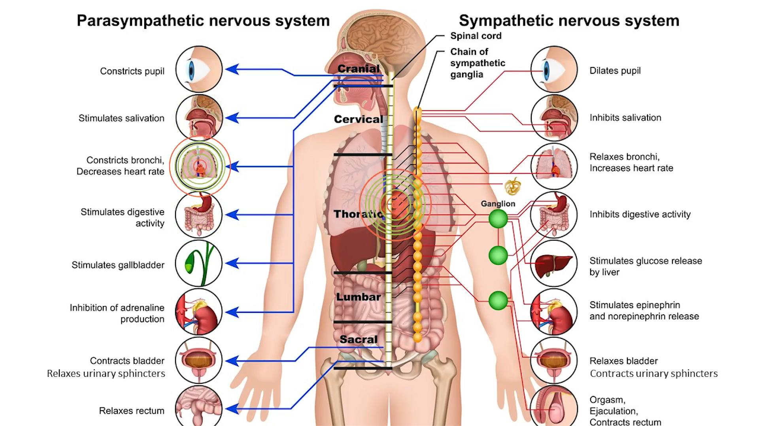

Slide 14


Slide 15
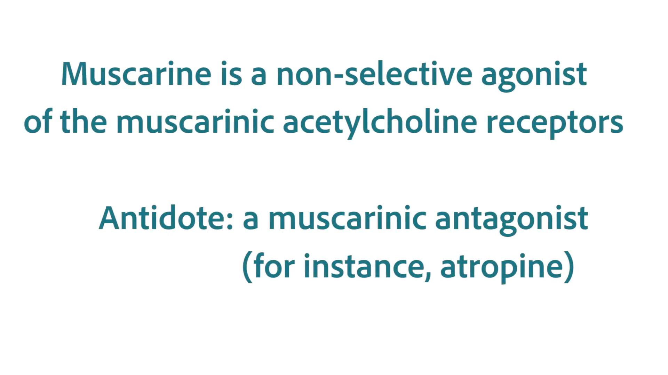

Slide 16
Cholinergic agents
Direct acting or Indirect acting
Can be:
  Nicotinic
  Muscarinic (5 subsets)
    M1 brain (decreased in Alzheimer’s disease)
    M2 heart (cause decreased rate and force of heart beat)
    M3 relaxation of GIT, lacrimal secretion, pupil constriction, increased micturition and defecation, bronchoconstriction
    M4 and M5 (not elucidated)

Slide 17
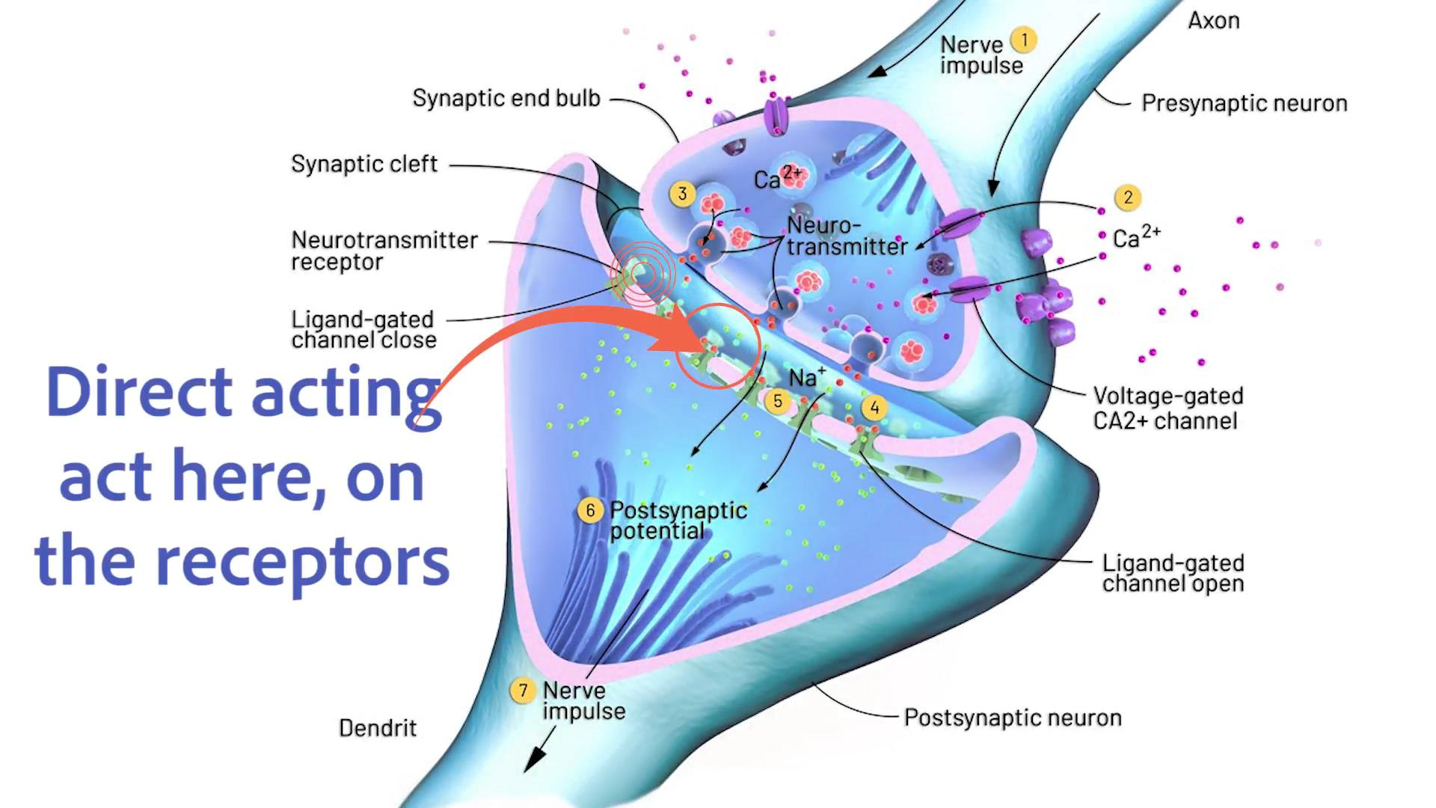
Direct acting cholinergic agents act on the receptors, acting like acetylcholine

Slide 18
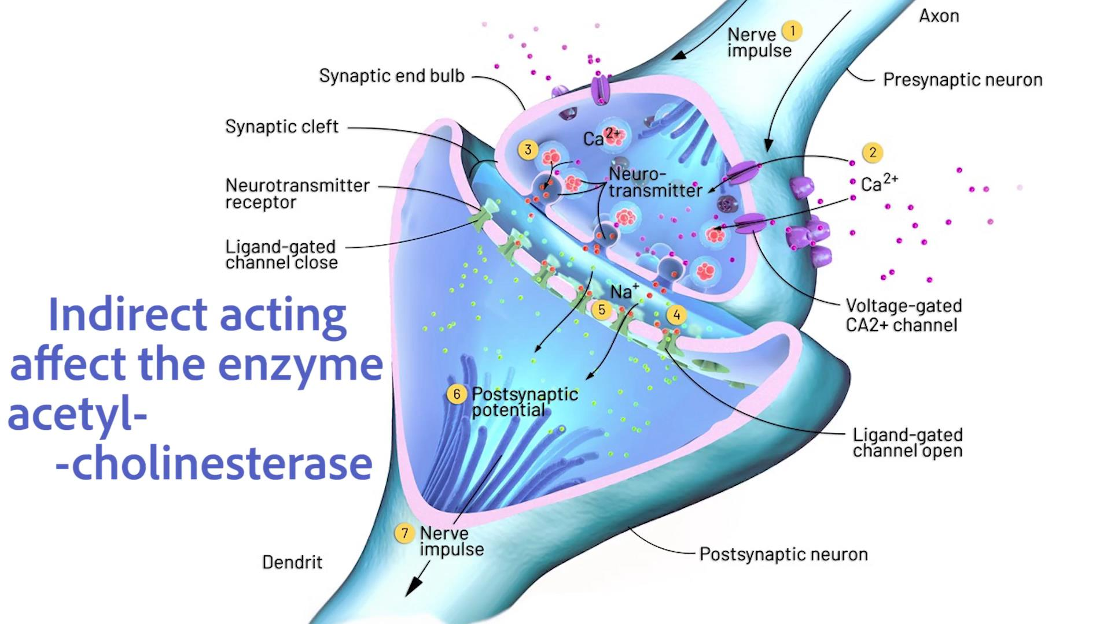
Indirect acting cholinergic agents act on the enzyme that degrades acetylcholine

Slide 19
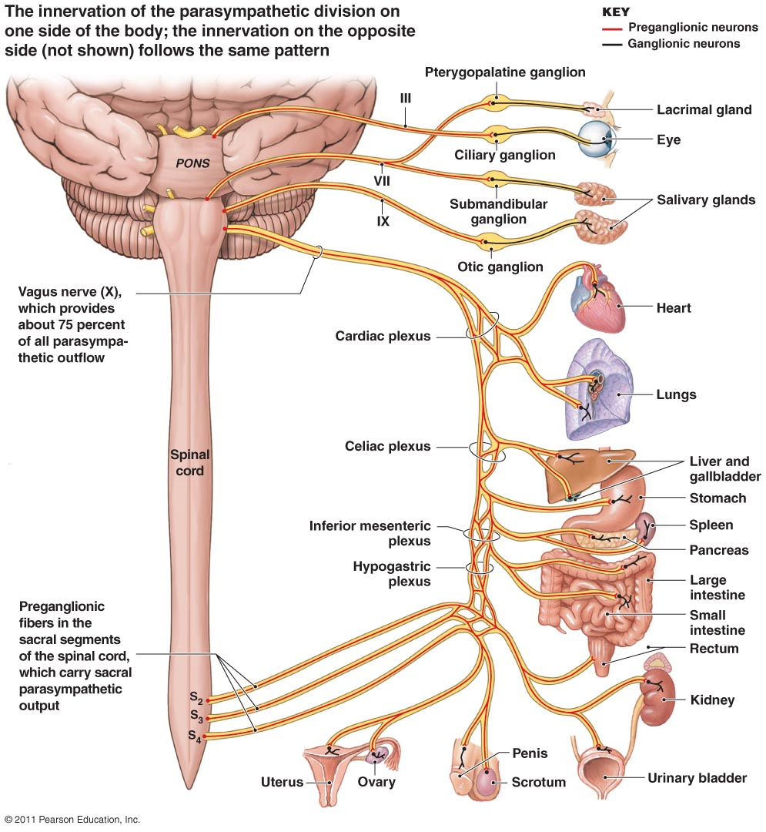

Thanks to Pearson Education 2011

Slide 20
Cholinergic agents
Direct acting or Indirect acting
Can be:
  Nicotinic
  Muscarinic (5 subsets)
    M1 brain (decreased in Alzheimer’s disease)
    M2 heart (cause decreased rate and force of heart beat)
    M3 relaxation of GIT, lacrimal secretion, pupil constriction, increased micturition and defecation, bronchoconstriction
    M4 and M5 (not elucidated)

Slide 21
Autonomic Nervous System Pharmacology
Drugs of the PNS
Lesson 3:
Understanding the difference between direct and indirect acting cholinergic agents
Introductory Pharmacology PHAR2001
Dr Ken Wojcikowski

Slide 22
Cholinergic agonists
Direct acting non-selective agonists include:
  Pilocarpine (know this drug; used to treat glaucoma. While this is a non-selective agonist, pilocarpine is administered topically and has little systemic absorption, therefore the actions are fairly limited to the m3 receptors in the eyes)
  Bethanechol (know this drug; previously used for non-obstructive urinary retention. Adverse effects: bradycardia, hypotension, diarrhoea, all consistent with parasympathetic stimulation.

Slide 23
Direct acting cholinergic agonists
Indications include non-obstructive postoperative and postpartum urinary retention
Topically in eye to reduce intraocular pressure of glaucoma, mydriasis
Adverse effects
    Extreme caution, even if used in eye
    Bradycardia,
    Hypotension,
    Nausea, vomiting,
    Diarrhoea, dehydration
    Bronchoconstriction

Slide 24
Autonomic Nervous System Pharmacology
Drugs of the PNS
Lesson 4:
Indirect acting acetylcholine inhibitors for Myasthenia gravis and Alzheimer’s disease
Introductory Pharmacology PHAR2001
Dr Ken Wojcikowski

Slide 25
Indirect acting cholinergic agonists
Act on acetylcholinesterase at the post synaptic cleft
  Prevents the breakdown of acetylcholine
    More acetylcholine remains longer
  Drugs cause a reversible bond; nerve gas is irreversible
Used for patients with:
  Myasthenia gravis
    (Edrophonium is used to diagnose myasthenia gravis)
    Neostigmine (know this drug) and pyridostigmine are used to treat MG
  Alzheimer’s disease
    Donepezil (know this drug)
    Galantamine (know this drug)
    Rivastigmine

Slide 26
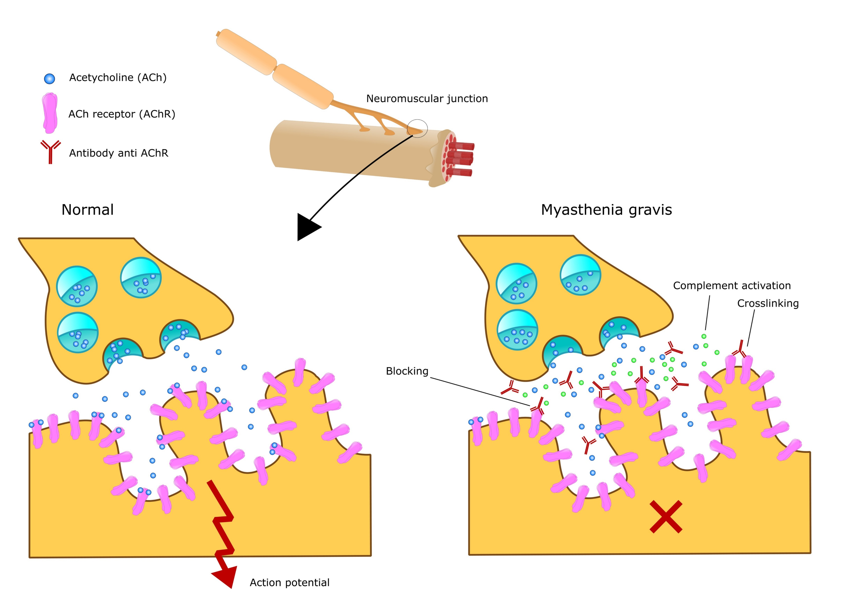
Myasthenia gravis

Slide 27
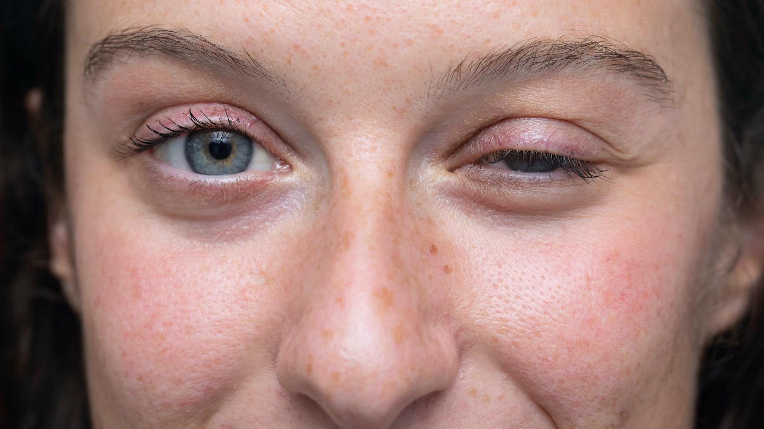
Myasthenia Gravis often affects facial muscles

Slide 28
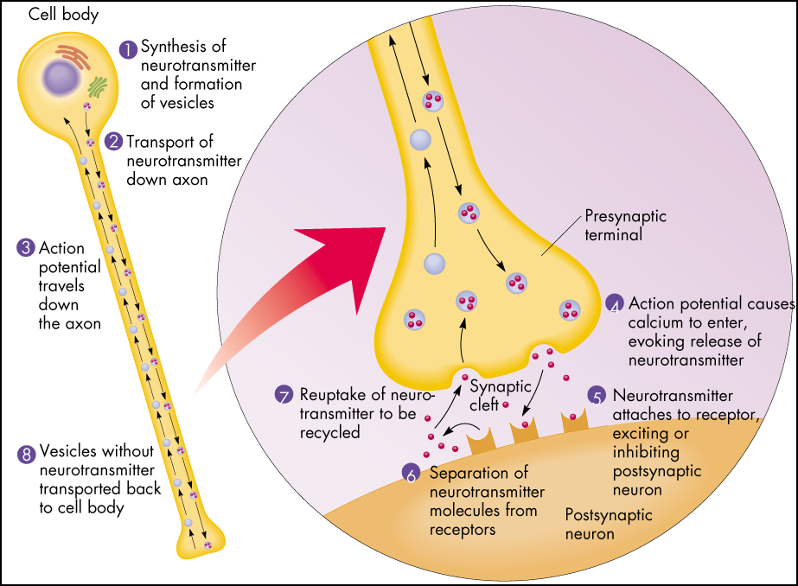
Myasthenia Gravis
Myasthenia gravis
  Autoimmune disorder
  Destruction of ACh receptors
Neostigmine
  Prevents breakdown of ACh
Side effects:
  Bradycardia
    Normally taken with a parasympatholytic such as atropine.
  Anorexia, nausea, vomiting, abdominal cramps, and diarrhoea

Slide 29
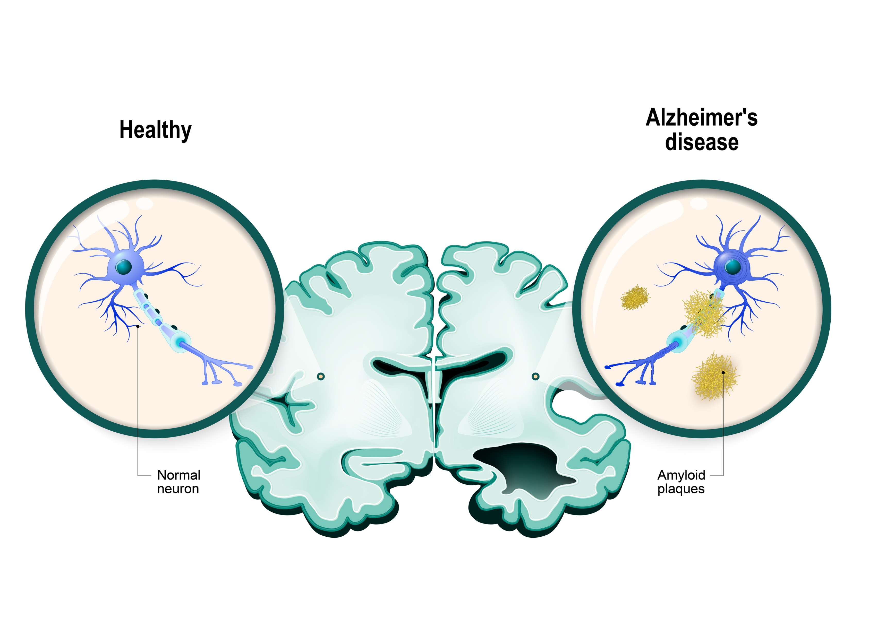
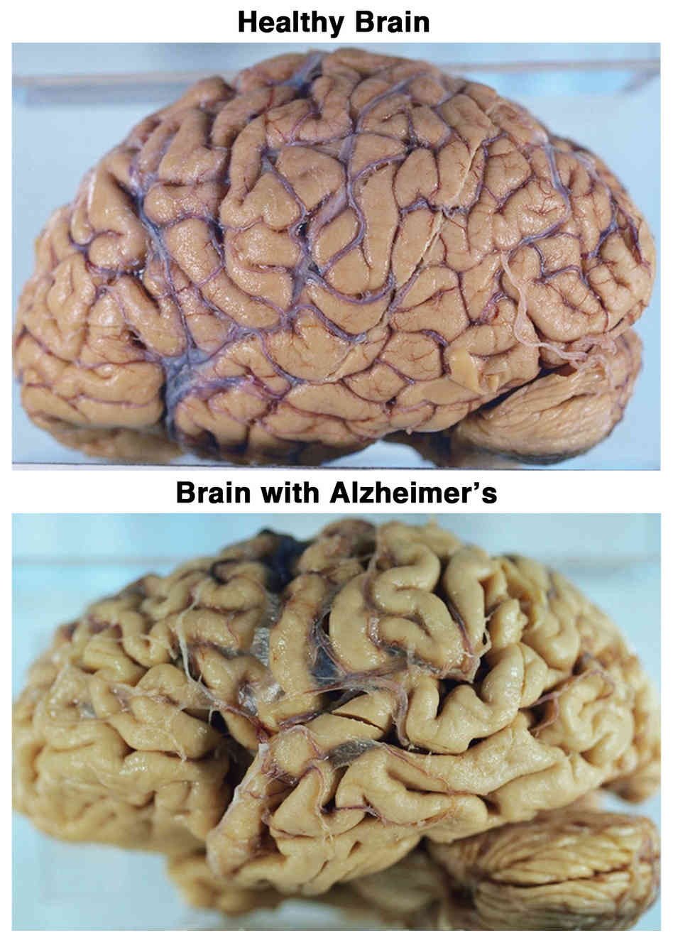
Alzheimer’s disease
Alzheimer’s disease
Progressive loss of ACh neurons
Galantamine
  Acetylcholinesterase inhibitor
Git complaints

Slide 30
Alzheimer’s disease
Progressive loss of ACh neurons
Galantamine
  Acetylcholinesterase inhibitor
Git complaints

Slide 31
Advanced Alzheimer’s disease
Donepezil (Aricept; know this drug)
  Reversible acetylcholinesterase inhibitor that is 100% bioavailable and crosses the BB barrier
  Two clinical trials indicate it may be effective for moderate to severe Alzheimer’s disease
Should be used with caution in patients with cardiac disease, cardiac conduction disturbances, chronic obstructive pulmonary disease, asthma
Patients with gastrointestinal disorders should use caution because nausea or vomiting may occur.

Slide 32
Autonomic Nervous System Pharmacology
Drugs of the PNS
Lesson 5:
Anticholinergic agents
Introductory Pharmacology PHAR2001
Dr Ken Wojcikowski

Slide 33
Anticholinergic agents
Other terms used:
Anticholinergics
Parasympatholytics
Muscarinic antagonists
Antimuscarinic agents
Allows the sympathetic system to dominate

Slide 34
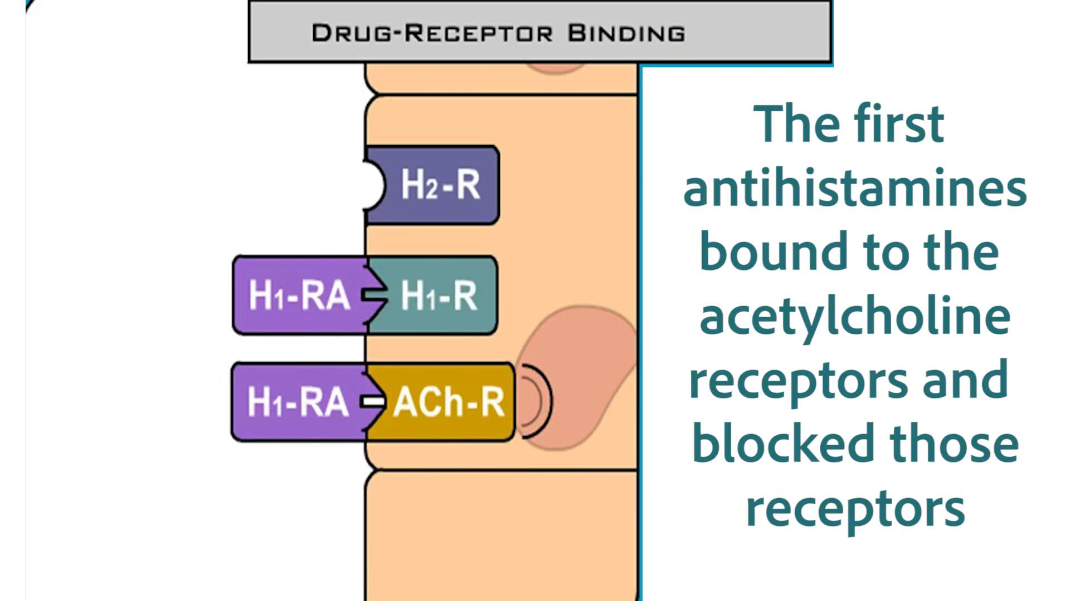
Many of our medications inadvertently bind to and block the acetylcholine muscarinic receptor

Slide 35
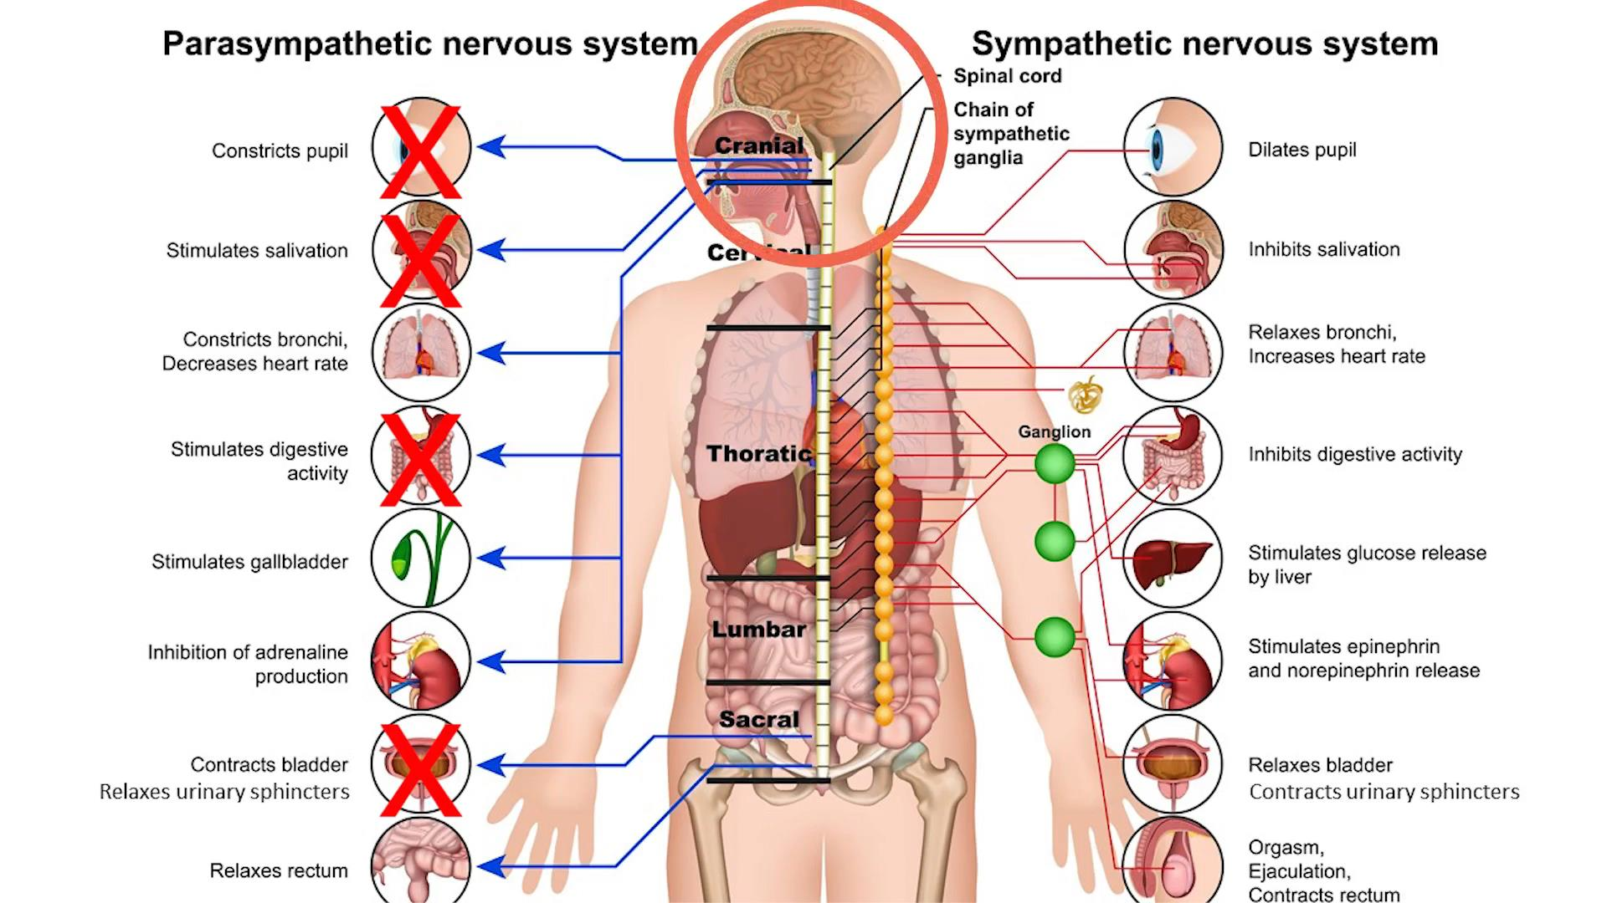
Anticholinergic agents allow the sympathetic nervous system to dominate

Slide 36
Muscarinic antagonists
Include
  Atropine (know this drug)
  Hyoscine
  Hyoscamine
  Cyclopentolate
Indications:
  Antispasmodics in GIT spasm,
  Counterbalance bradycardia
  Antiemetic
  Antiasthma agent
  Treatment of urinary frequency

Slide 37

Deadly nightshade contains atropine that is an anticholinergic agent

Slide 38
This is a common mnemonic for anticholinergic overdose
To describe the physiologic manifestations of atropine overdose:
“Hot as a hare, blind as a bat, dry as a bone, red as a beet, and mad as a hatter“ describing
warm, dry skin from decreased sweating,
blurry vision, decreased lacrimation,
vasodilation, and
central nervous system effects on muscarinic receptors
This set of symptoms is known as anticholinergic toxidrome, and may also be caused by other drugs with anticholinergic effects, such as hyoscine hydrobromide (scopolamine), diphenhydramine, phenothiazine antipsychotics and benztropine

Slide 39
References
Goldsy RA et Al. Immunology 5th ed. WH Freeman Publishers, 2003
Marieb E. Human Anatomy and Physiology, 5th ed. Benjamin Cummings, San Francisco, 2001
Rad, CC BY-SA 3.0 <http://creativecommons.org/licenses/by-sa/3.0/>, via Wikimedia Commons
Martini FH, et al. Visual Anatomy and Physiology 1st ed. Benjamin Cummings, 2011
Royalty free images from Shutterstock
The PowerPoint and associated Video were edited and produced by Dr. Ken Wojcikowski

